Slide 1

Project Title: Social Networking Platform Subtitle: Connecting People with Code Presented by: Hamza Farooq ,Nadir Abbas ,Adil Shahzad, Dawood Ikram, Farha, Sadia.

Slide 2
Details About Our Project 1).We have created this project using C++. 2).In this project, the user creates their profile, meaning they can sign up or log in. 3).The user can add friends, make posts, and any friend can comment on those posts. 4).The user can also view their list of friends to see who is connected with them. 5).At last user can logout his ID if he wants.

Slide 3
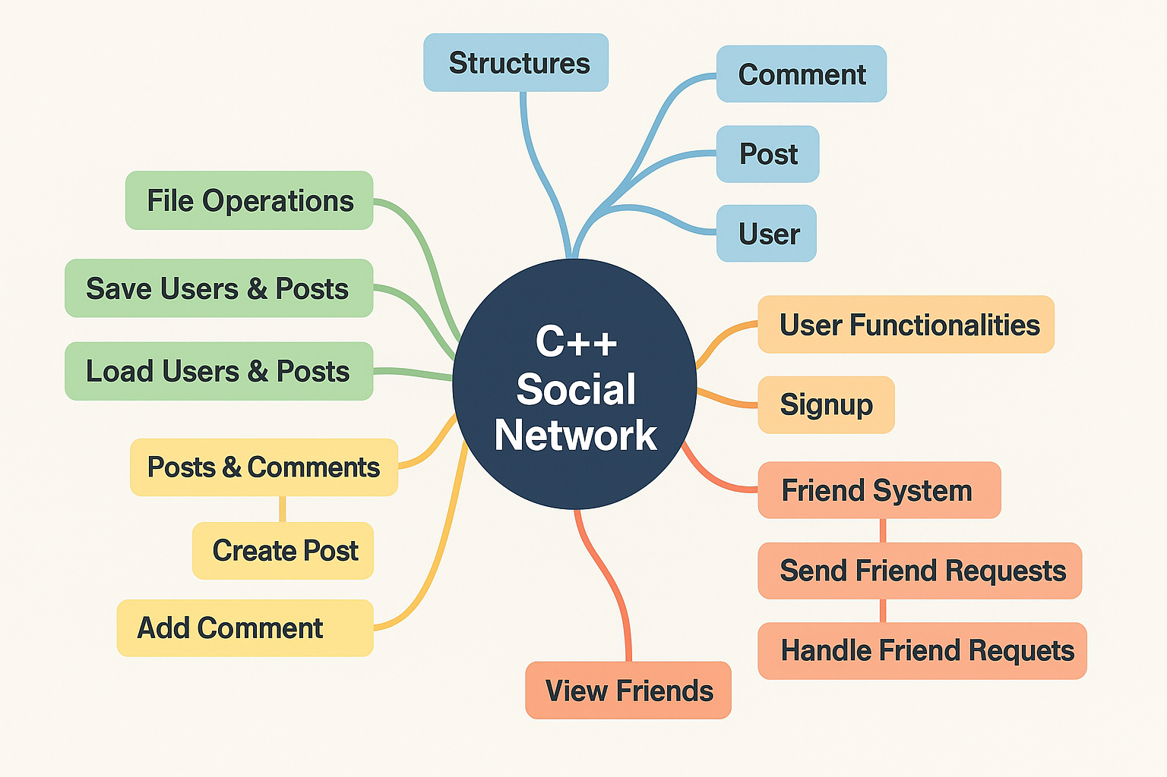

Slide 4
Header Files #include <iostream> #include <vector> #include <string> #include <fstream> using namespace std;
Explaination
#include <iostream> → For Input/output (like cin, cout).
#include <vector> → For Using Dynamic array
#include <string> → For Strings Handling
#include <fstream> →For File handling (ifstream, ofstream).

Slide 5
User Details for Signup\Login struct User { string username; string password; vector<string> friends; vector<string> friendRequests; };
Explaination
username, password → For authentication
friends →The List Of Friends.
friendRequests → Pending Friend Requests.

Slide 6
Showing Users vector<User> users; vector<Post> posts;
Explaianation
users: All registered users.
posts: All posts.
For Saving User’s Data
void saveUsers()
Explaination
Uses a folder in memory ‘users.txt’to save the login info of user.

Slide 7
Signup Function Signup() Function For a New User string username, password;(for a new user) ------
bool login()
string username, password; (for existing user)
----
void createPost() (for creating a post)
string content;() (for writing post content)

Slide 8
For Creating a Post Struct Post { string author; string content; vector<Comment> comments; };
Explaination
Post → structure
author → User who is Posting
content → The Text Of Post
comments → comments vector below the post

Slide 9
Commenting on a post struct Comment { string author; string content; };
For comment structure:
author → The person who is commenting
content → The text of comment

Slide 10
THANK YOU.

